Slide 1
3-Fortran basic

Slide 2
Do loop
Do Enddo
Do i=1,100 [,step]
End do
Do x=0.1,100.0,0.1
End do
Do
End do

Slide 3
Example counts 1 to 100
K=0
Do i=1,100
k=k+i
End do
Print*,k

Slide 4
Example plot sin curve
Xstep=3.141592654/1000.0
Do x=0.0,3.1416,xstep
y=sin(x)
print*,x,y
End do

Slide 5
Simple Do End do case
Open(1,file=‘test.txt’,status=‘old’)
Do
read(1,*,err=99)a,b,c
if (a < 0.0) exit
End do
99 close(1)

Slide 6
Exit and Cycle in the loop
Exit
Escape the loop (end of the loop)
Cycle
Still in the loop jump to next round

Slide 7
Exercise on Exit and Cycle
Do
!– Cycle to here
Print ‘Input a value’
read(*,*) x
if(x .lt. 0.0)exit
if(x .gt. 0.0)cycle
print ‘Input value = 0.0’
End do
!--- Exit to here

Slide 8
Multiple loops
Do i=1,3
do j=1,3
print*,I,j
end do
End do
Run
1,1
1,2
1,3
2,1
2,2
2,3
…..

Slide 9
Do while
Do while (logical condition)
logical condition is true, loop will go on and false will end of the loop.
邏輯運算成立時會一直執行
不成立就會跳出
End do

Slide 10
Example
K=0
Do i=1,100
k=k+i
End do
Print*,k
i=1
Do while ( i .le. 100)
k=k+i
i=i+1
End do
Print*,k

Slide 11
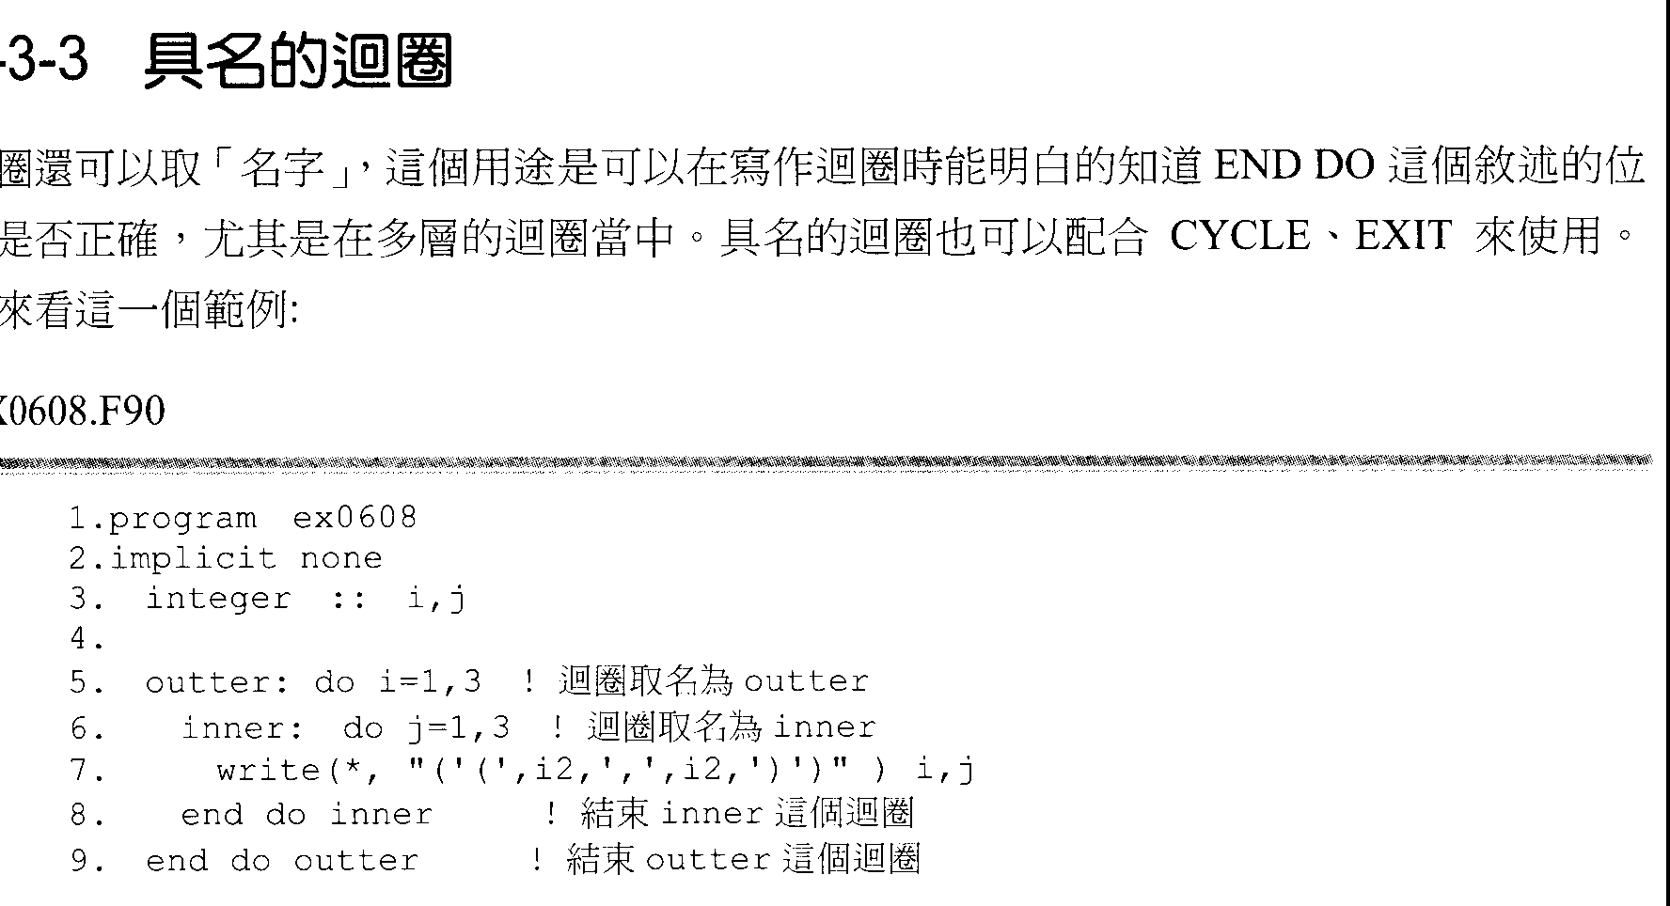
Named loop for easy to identify multiple loops

Slide 12
Named loop for easy to identify multiple loops
A DO LOOP can be named to check whether END DO is at the right position (especially in nested loops).
CYCLE and EXIT can be used with a named loop.

Slide 13
Exercise on loop
請將從100至99999中17的倍數之和算出。
Counting the sum of 17 multiple number from 100 to 99999

Slide 14
Array
Integer A(100),B(100,100,100)
Real C(200)
Complex D(300)
Character F(999)
Maximum 7 Dimensions
Cannot use outside the range of declared array, it will cause the memory error!
Real A(100) can not use to a(101)

Slide 15
Setting initial values
Integer a(5)
Data a/1,2,3,4,5/
Data a/5*0/ ➔/0,0,0,0,0/
Data (a(i),i=2,4) /2,3,4/

Slide 16
F90 Array operation
A=0.0
Do i=1,n
A(i)=0.0
End do
A=B
Do i=1,n
A(i)=B(i)
End do
A=B*C
A(i)=B(i)*C(i)
A=A-B
A(i)=A(i)-B(i)
A=sin(B)
A(i)=sin(B(i))

Slide 17
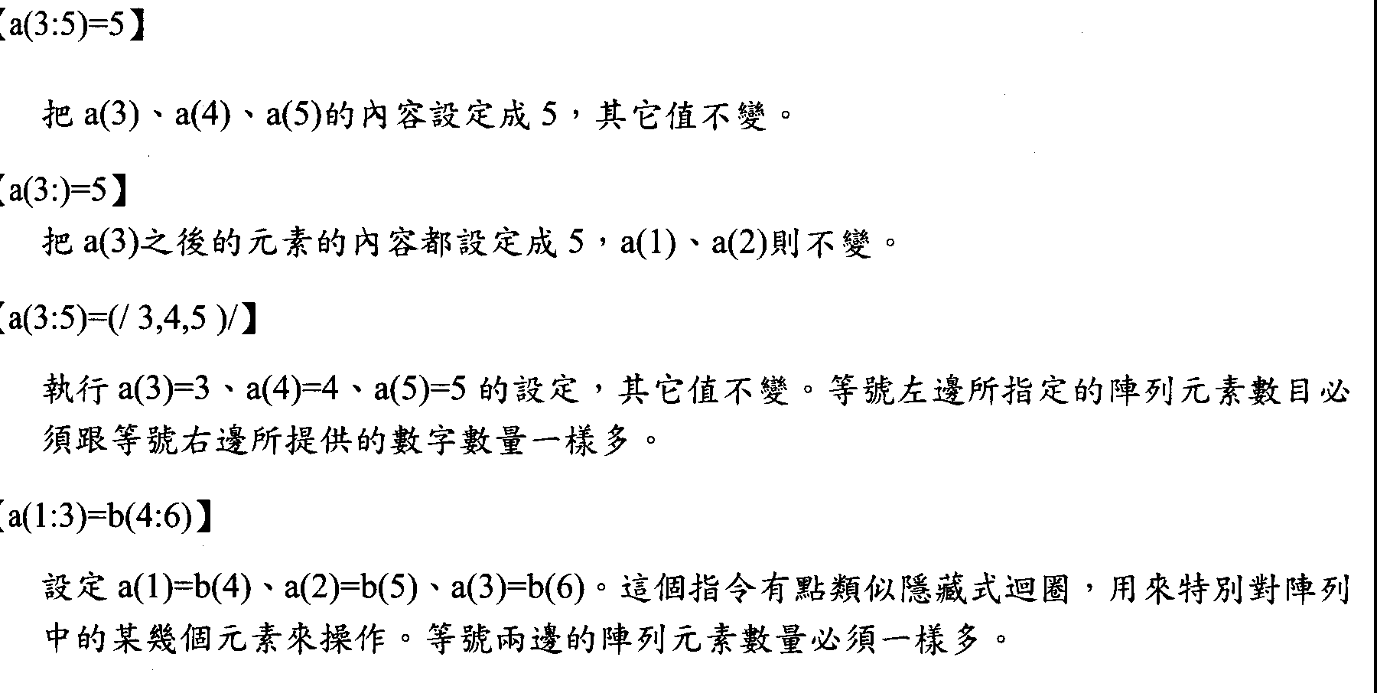

Slide 18
Assign 5 to a(3), a(4), and a(5). Other positions are not changed.
Assign 5 to all positions after a(3). a(1) and a(2) are not changed.
Assign 3 to a(3), 4 to a(4), and 5 to a(5). Other positions are not changed.
The number of elements indicated at left must be equal to the number of values provided at right
Assign a(1)=b(4), a(2)=b(5), and a(3)=b(6). It is similar to an implicit loop using on operating several elements in an array.
The numbers of elements indicated at both sides should be equal.

Slide 19
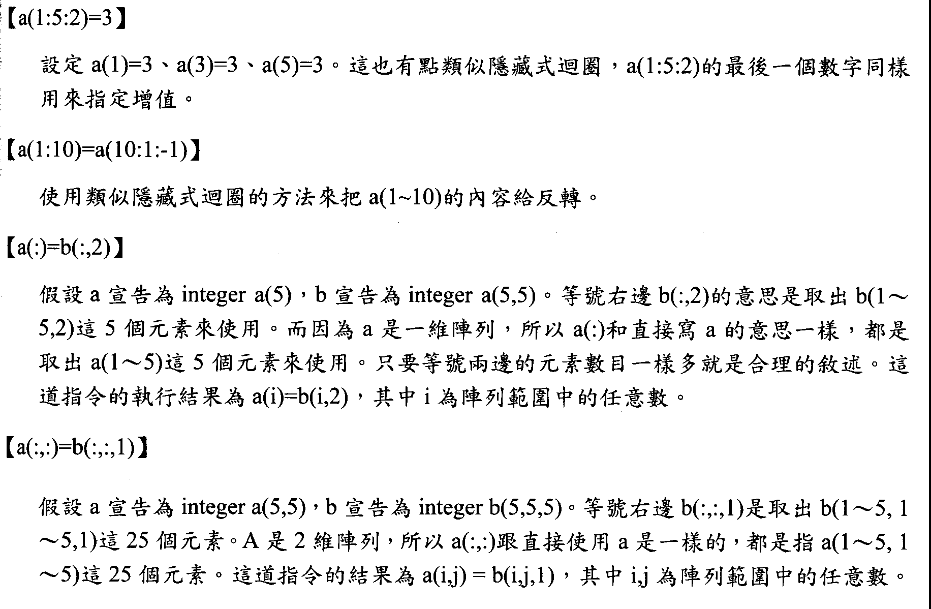

Slide 20
Assign a(1)=3, a(3)=3, and a(5)=3. It is similar to an implicit loop too.
The last number in a(1:5:2) is used to indicate the increment.
Reverse the order of the values in an array.
Assuming a is declared as integer a(5), b as integer a(5,5). b(:,2) means taking the 5 elements from b(1~5,2). a is an one-dimensional array, so a(:) is the same as a. Both means taking 5 elements from a(1~5). If the numbers of elements at both sides are equal, it is a reasonable assignment. After execution of the assignment, a(i)=b(i,2), i is any index number in the range of the array.
Assuming a is declared as integer a(5,5), b as integer a(5,5,5). b(:,:,1) at right side means taking the 25 elements from b(1~5,1~5,1). a is an two-dimensional array, so a(:,:) is the same as a. Both means the 25 elements from a(1~5, 1~5). After execution of the assignment, a(i,j)=b(i,j,1), i,j are any index number in the range of the array.

Slide 21
Allocatable, allocate, deallocate
Integer, allocatable :: a(:)
i=99999
Allocate( a(i) , stat=ierr)
ierr==0 OK!, ierr/=0 allocate error!
Deallocate(a)

Slide 22
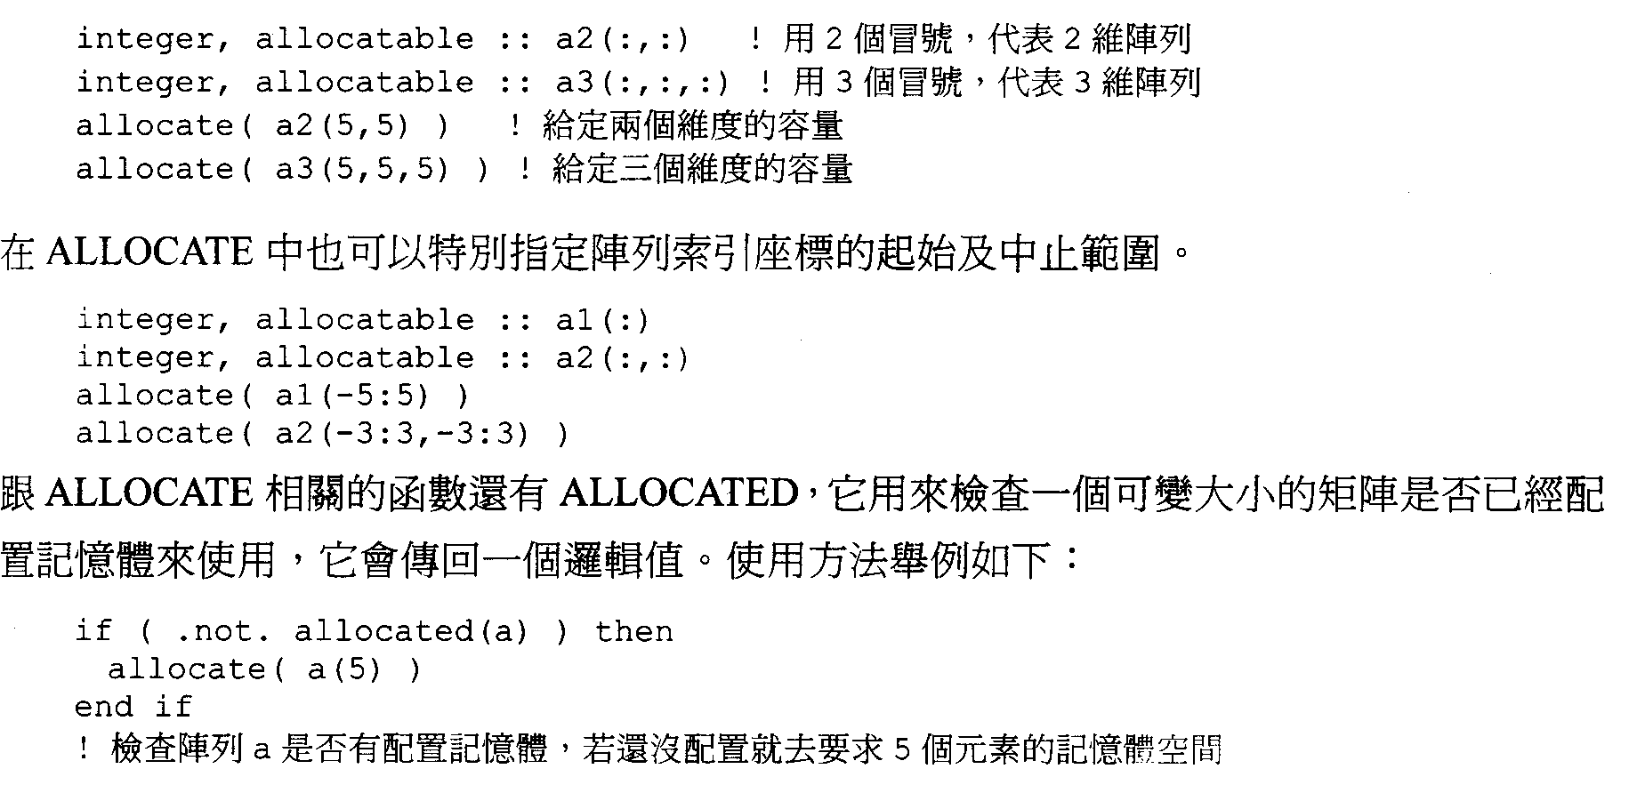

Slide 23
Two colons are used to indicate a 2-dimensional array
Two colons are used to indicate a 2-dimensional array
Three colons are used to indicate a 3-dimensional array
(Allocate memory fitting to the 2-dimensional array)
(Allocate memory fitting to the 2-dimensional array)
The first and last indexes can be assigned with ALLOCATE.
ALLOCATED is an ALLOCATE related function. It is used to check the allocation status of an array. The return value is a LOGICAL. Example:
Check whether array a is allocated or not. If it’s not, memory with the size for 5 elements will be allocated.

Slide 24
Homework 3-1
Please read epicentral distance as Xi and P travel time as Yi from the file, ppfile.txt. Using a line Y=aX+b to fit it. Please finds the values of constants a, b, fitting standard deviation (s.d.v.), linear correlation coefficient R, and the s.d.v. of a and b.

Slide 25
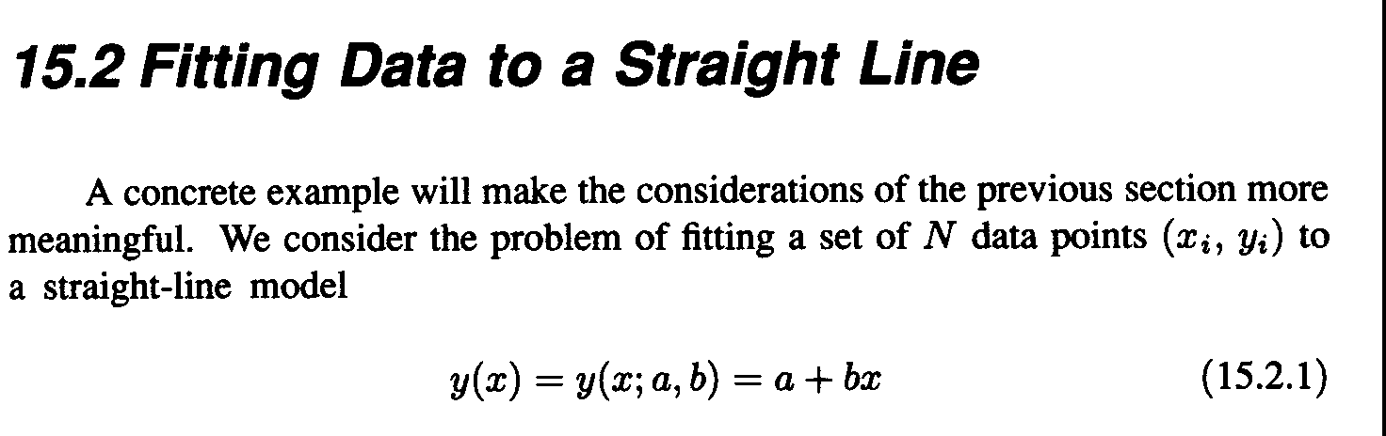

Slide 26
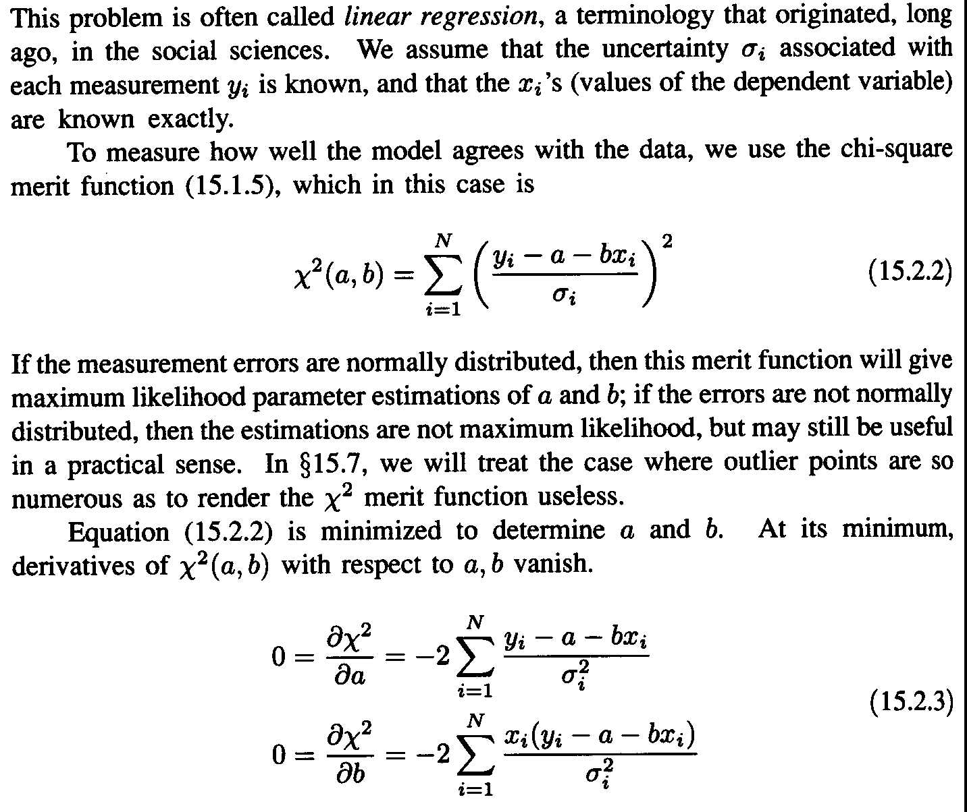

Slide 27
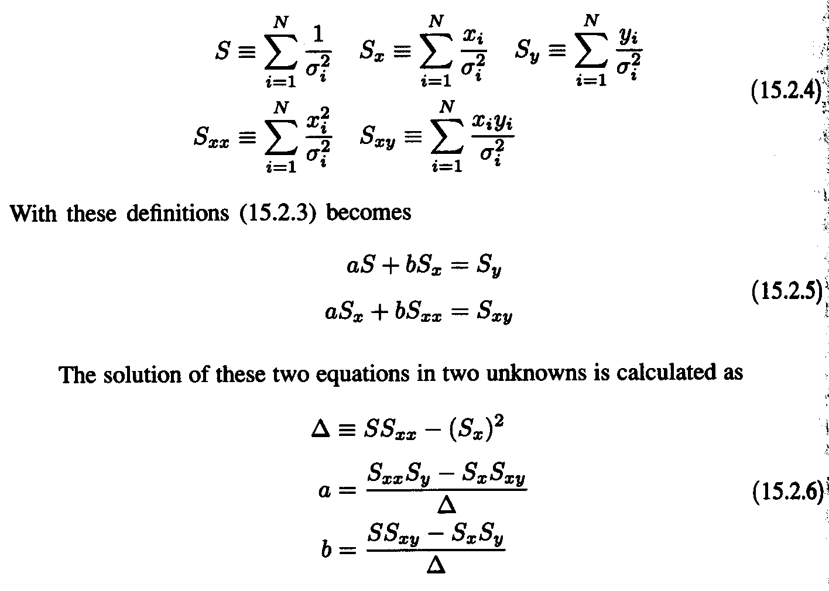

Slide 28
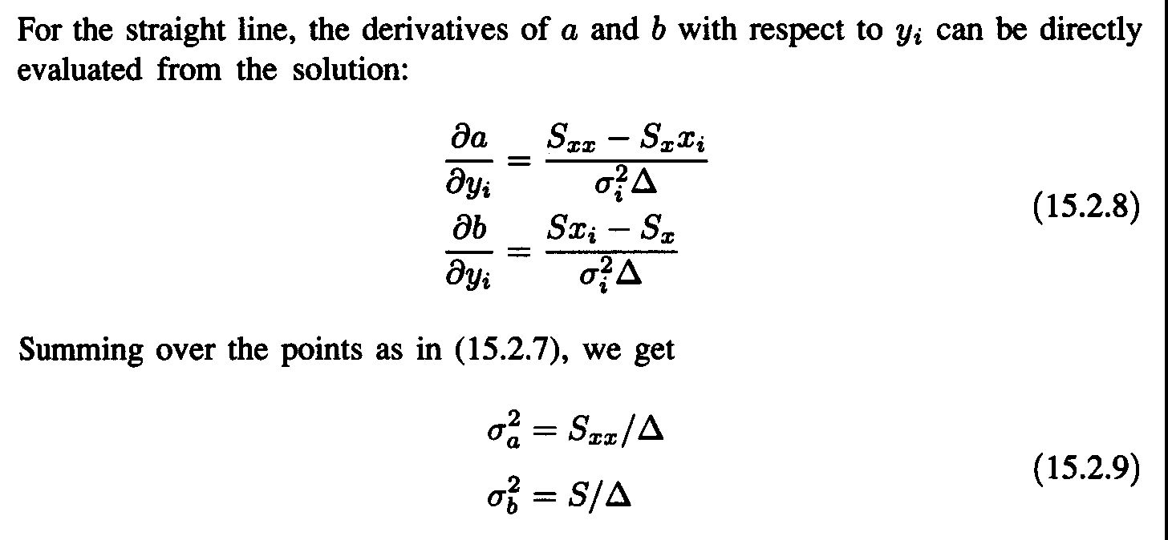

Slide 29
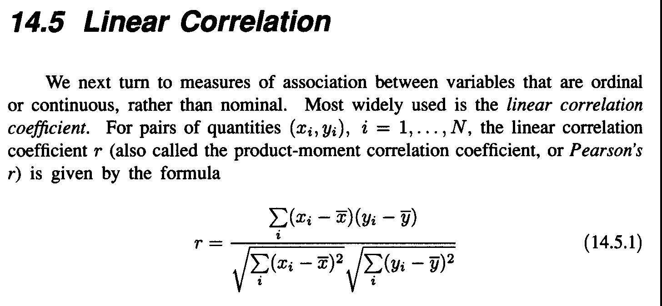

Slide 30
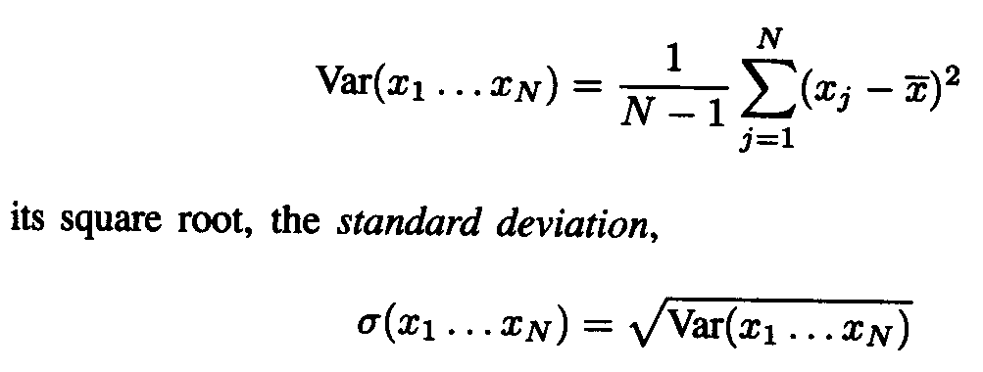

Slide 31
Homework 3-2
Please write a program to find any 3X3 matrix’s inverse matrix.
Input
2 3 6
1 4 9
2 6 1
Output inverse matrix

Slide 32
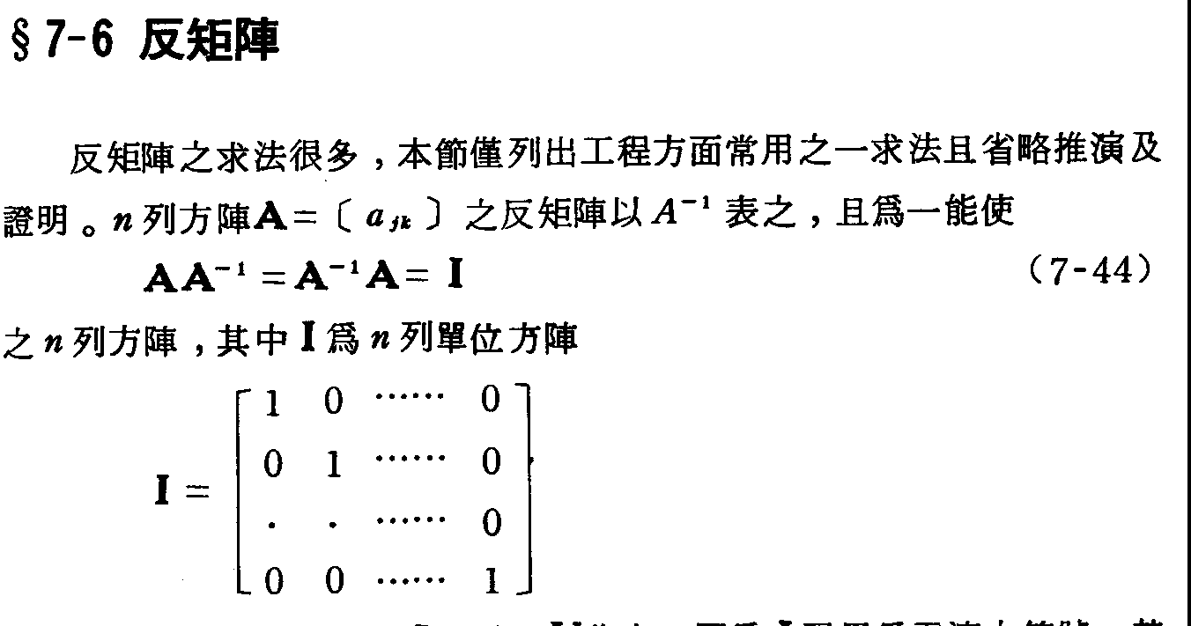

Slide 33
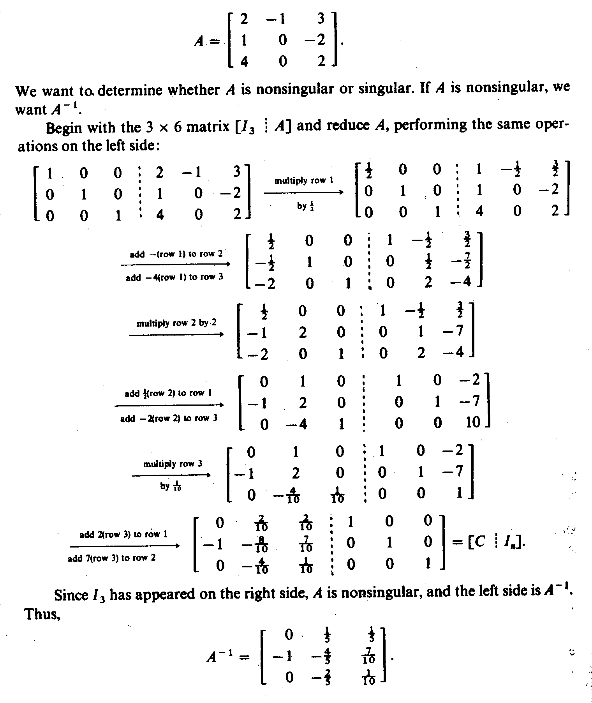

Slide 35
Least-squares
d = G m
m = [G^{t}G] ⁻¹ G^{t} d

Slide 36
program hk3_1
real x(999),y(999),xsec
integer iy,im,id,ih,mm
open(1,file='ppfile.txt',status='old')
read(1,'(1x,i4,4i2,f6.2)')iy,im,id,ih,mm,xsec
xsec=mm*60.0+xsec
do i=1,999
read(1,'(5x,f6.1,9x,i3,f6.2)',err=99)x(i),mm,y(i)
y(i)=mm*60.0+y(i)-xsec
print*,x(i),y(i)
enddo
99 close(1)
np=i-1
print*,'Total : ',np,' points'
end program hk3_1

